Slide 1
Capstone Project Author Analysis
By
Shivanshu Kumar Srivastava

Slide 2
Publications
Author Analysis
Publishers Analysis
Title Analysis
Sales Analysis
Sales Analysis
Stores Analysis

Slide 3
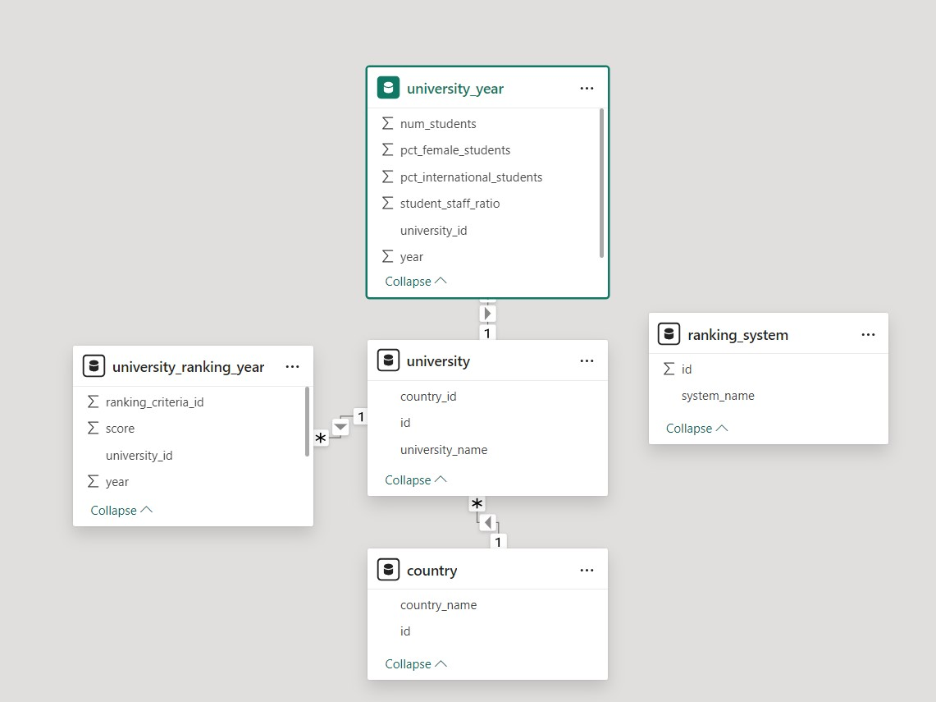
ER Diagram

Slide 4
Power BI Problem Statements

Slide 5
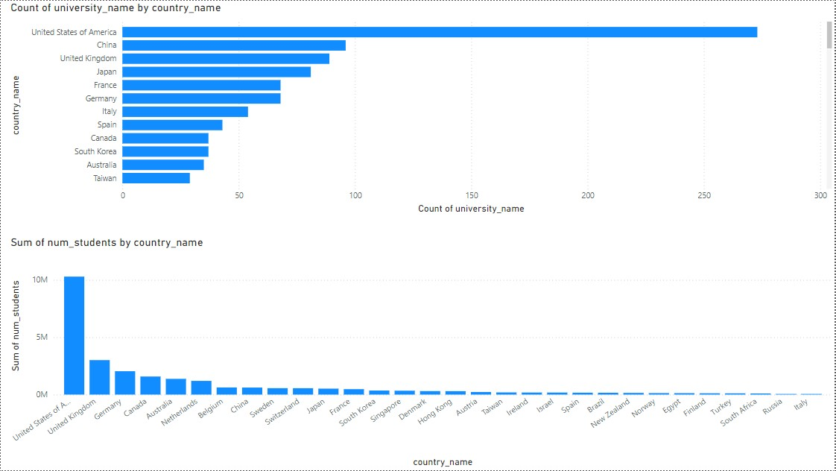
How many universities are there in each country?
In USA there are many country.
Is about to 275.
Just solve from Power Bi.

Slide 6
What is the distribution of international students across different countries?
About 10M Students are in USA
On second UK that about to 2.6M

Slide 7
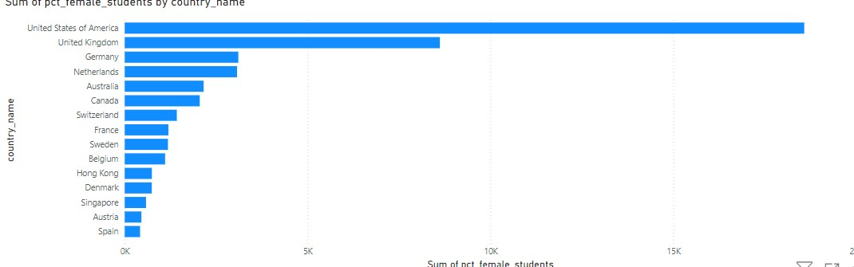
Which country has the highest number of female students enrolled in universities? 4 How many universities are ranked by each ranking system?
About 18k Female Students are in USA
On second UK that about to 8k

Slide 8
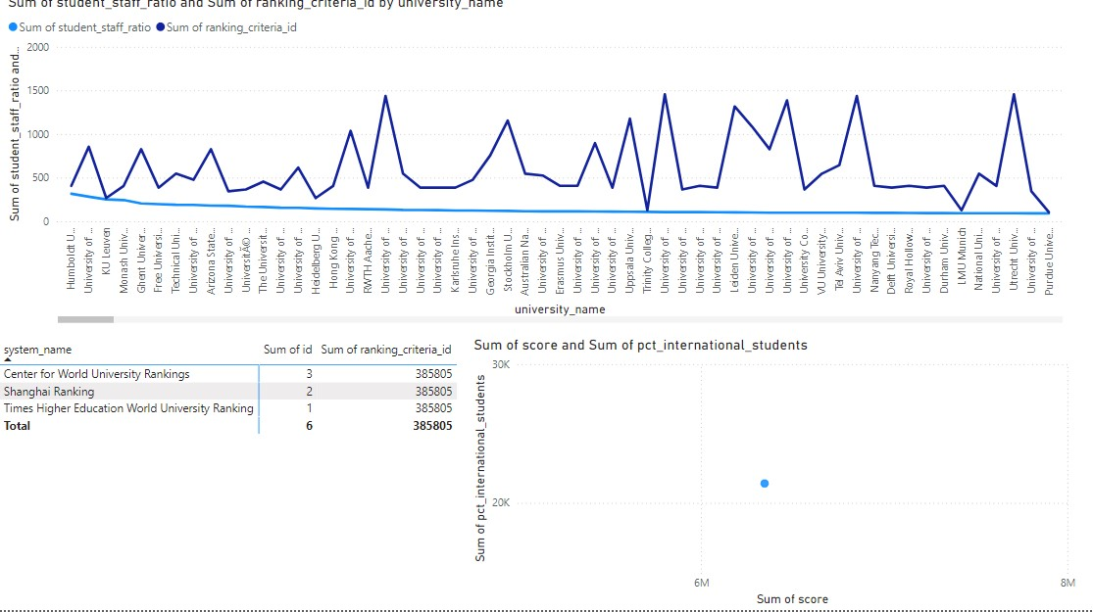
How does the ranking system affect a university's student-staff ratio?
These are the sum of Ranking Criteria by System Name
These are felxible

Slide 9
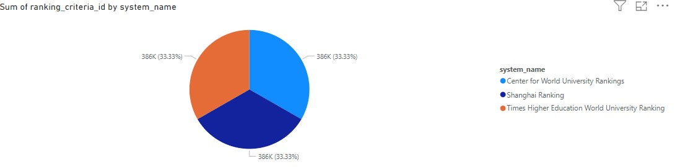
What are the most important criteria considered by ranking systems?
These are ranking Criteria considered by ranking system
These are about same
These is pie chart showing ranking systems.

Slide 10
Is there a correlation between a university's score and the number of international students?
These are correlation between university’s score and the no of international students.
These are blue dot showing its relation.

Slide 11
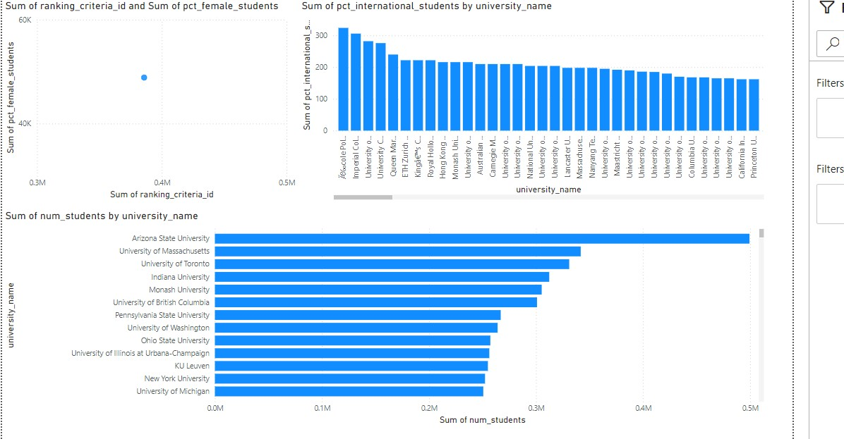
How does the percentage of female students impact a university's ranking?
These are correlation between female students by university Ranking.
These are blue dot showing its relation.

Slide 12
Which university has the highest number of students?
In this Chart show the highest no of students.
Its Arizona State University.
About to 0.5M Students.

Slide 13
How does the percentage of international students vary across different universities?
In this Chart show the highest no of International Students.

Slide 14
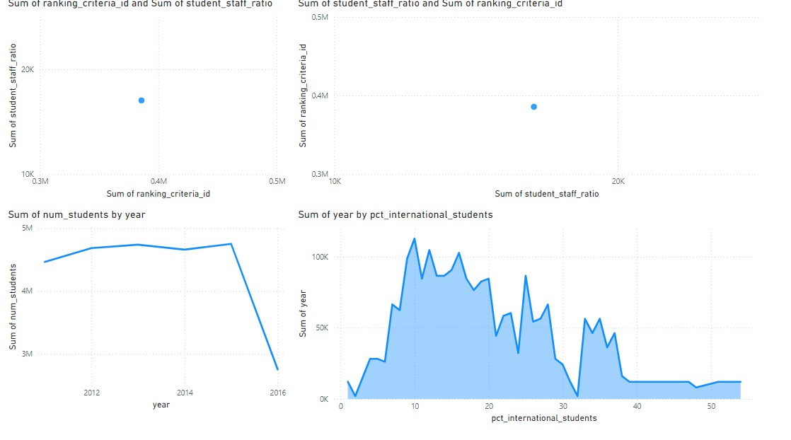
Is there a correlation between a university's ranking and its student-staff ratio?
These are correlation between by university Ranking and Student Staff Ratio.
These are blue dot showing its relation.
.

Slide 15
How does the percentage of international students vary across different years?
This graph shows the international students vary across different years.
This graph are very fluctuating across year.
.

Slide 16
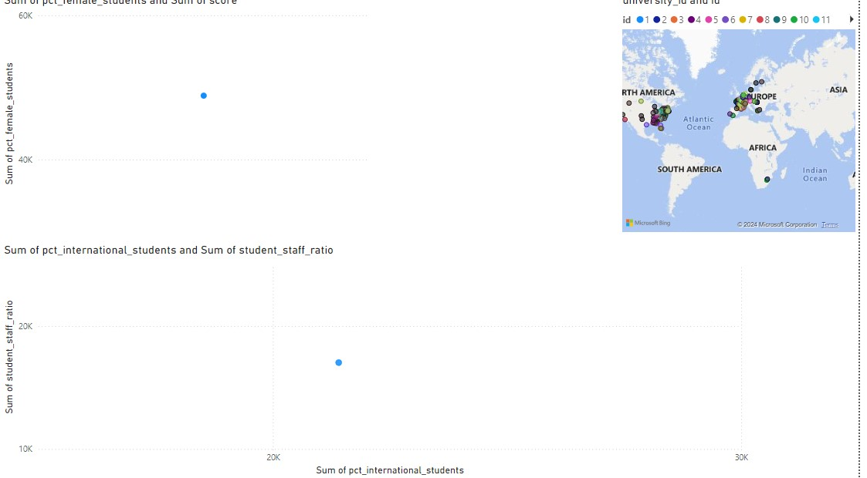
Is there a relationship between a university's ranking score and the percentage of female students enrolled?
This scatter graph shows relationship between university ranking score and the % of female students enrolled.
Blue dot shows its relation.
.

Slide 17
How does the percentage of international students affect a university's student-staff ratio
This scatter graph shows international students affect a university’s student staff ratio.
Blue dot shows its relation.
.

Slide 18
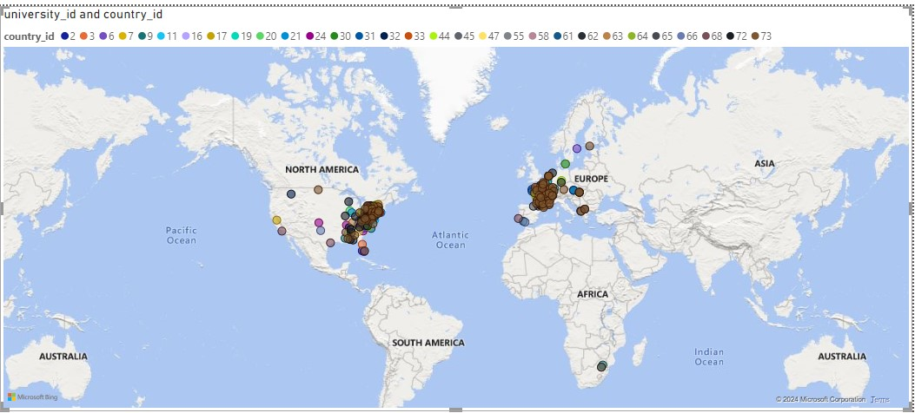
Are there any significant trends or patterns in the rankings of universities from different countries?
Yes they are significant trends or patterns in ranking of universities from different countries.
.

